Slide 1
European Legislation
Lecture Title: Principles of supremacy, direct effect, indirect effect and state liability
Lecturer: Dr Christopher L. Vella
Diploma in Law (Malta)
Date: 27th January 2022

Slide 2
Part I: Principle of supremacy

Slide 3
Supremacy of Union Law
Founding treaties were silent on this principle
Which law prevails in case of conflict between National and EU Law?
EU LAW IS ABSOLUTE AND UNCONDITIONALLY SUPREME
All sources of EU law prevail over national laws

Slide 4
Development by CJEU
Developed by the CJEU in Flaminio Costa v
Enel (Case 6/64)
“By creating a Community of unlimited duration, having its own institutions, its own personality, its own legal capacity and a capacity of representation on the international plane and, more particularly, real powers stemming from a limitation of sovereignty or a transfer of powers from the States of the Community, the Member States have limited their sovereign rights, albeit within limited fields, and have thus created a body of law which binds both their nationals and themselves”

Slide 5
Rationale for supremacy
A uniform common market could not be achieved if EU Law is subordinate to national law of the various states.
National courts are required to give effect to EU law
1. Contractarian Argument: Flowed from the Accession Agreements – by transferring certain competences to the EU, Member States have limited their sovereignty.
2. Functional Argument: Aims of integration and cooperation would not be achieved if one MS refuses to give effect to Union Law. Uniformity.
3. Analytical Argument: In practice the direct applicability of EU Law would be meaningless if MS were permitted to nullify the effects of EU Law by national legislation

Slide 6
Does EU Law prevail over all laws? What about constitutional rights or Human Rights?
Internationale Handeelgsgellschaft vs Einfuhr (1970) (C-11/70)
Not even a constitutional provision could override the supremacy of EU Law.
Not even a fundamental human right
Ciola v Land Vorarlberg – 1999 – Not even administrative acts

Slide 7
What if the national law pre-dates the EU Law?
Amministrazione delle Finanze dello Stato v
Simmenthal Spa – 1978
Supremacy of EU Law applied irrespective of
whether the national law pre-dated or post- dated
EU Law. Even if that law was enacted prior to
entry into force of EU law in that MS

Slide 8
Is the Court required to nullify the national law first?
Simmenthal case – Not necessary to nullify the national law first
Not requiring the national court to invalidate or annul the provision of national law but rather to refuse to apply it
Eventually, to ensure legal certainty, an express repeal of conflicting pre-exsiting legislation may be required (Commission v. France, C-167/73)

Slide 9
Should the national judge declare the national provision as null and void?
C-22/97, Ministero delle Finanze – No. National Judges must disapply inconsistent national provisions, whilst ensuring that any rights conferred by EU Law are enforced under the domestic procedure
May suspend the inconsistent provisions of national law as an interim measures

Slide 10
Is the doctrine of supremacy applicable to res judicata?
Is the national judge obliged to review and set aside a judgment of the national courts which has become final and thus has acquired the status of res judicata, if incompatible with a subsequent judgment of the CJEU?
Kapferer cases – C-234/04
NO!
The principle of res judicata prevails
Ensures stability of law, legal certainty and sound administration of justice
BUT …

Slide 11
What if allocation of exclusive competences is at stake?
C-119/05 – Lucchini – related to state aid incompatible with the common market – CJEU imposed a restriction on res judicata over the principle of spuremacy
It ruled that a national judgment that had become final but was in flagrant violation of the division of competences between EU and Member States was in breach of EU Law and could no longer enjoy the status of res judicata!

Slide 12
Declaration 17
The Treaty of Lisbon contains no article formally enshrining the supremacy of Union law over national legislation, but a declaration was attached to the Treaty to this effect – Declaration No. 17
“…. The Treaties and the law adopted by the Union on the basis of the Treaties have primacy over the law of Member States, under the conditions laid down by the said case law”
Council Legal Service opinion – not being included in a Treaty shall not in any way change the existence of the principle

Slide 13
Role of the CJEU
Importance of case law for the principle of supremacy

Slide 14
Diploma in Law (Malta)

Slide 15
Part II: Direct effect and Indirect Effect

Slide 16
Art. 258 TFEU - Ineffective means of enforcement
Mechanism initiated by the Commission against defaulting Member States to ensure that a state complies with Union law obligations
A penalty may also be imposed against the MS
BUT
INDVIDUALS HAD NO REMEDY

Slide 17
Problem solved
CJEU developed principles whereby an aggrieved national of a MS would be afforded rights which could in certain circumstances, be enforced in the courts of MSs
3 principles
Indirect effect
Direct Effect
State Liability

Slide 18
Direct effect
National courts may be unable to to interpret national law to avoid a conflict with Union law
Principle that an EU citizen may invoke European law before courts
Ensures application and effectiveness of EU law in EU countries
Effective supervisory mechanism – by individuals
Enhance uniformity

Slide 19
Van Gend en Loos v Nederlandse (C-26/62)
Developed the principle of direct effect
Could the claimant rely on a treaty article in the national court?
CJEU held that Union law is meant to provide obligations but also rights
Therefore a claimant may invoke EU law before the national court to challenge a national legislation
Therefore not only the Commission may now challenge Member States for incorrect application of EU law but ALSO CITIZENS.

Slide 20
Tests for Direct Effect
Provisions which are:
1. Sufficiently precise – a provision is to be sufficiently precise in order to have direct effect – Van Duyn v Home Office & Defrenne v SABENA
2. Unconditional – not subject, in its implementation or effects, to any additional measure by the Union or the Member States.

Slide 21
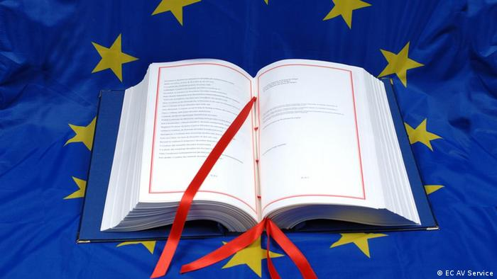
Do Treaty articles have direct effect?
Treaty provisions typically do not impose an obligation or a commitment
Van Gend en Loos – Had found that former article 12 of EC Treaty was directly effective against the State. Therefore Treaties are directly effective

Slide 22
Can an EU citizen invoke Treaty article against another citizen or undertaking
Defrenne v Sabena – C-43/75
Claim by an air stewardess against her employer for equal pay on basis of Art 119 EC Treaty
“…. the prohibition on discrimination between
men and women applies not only to the action
of public authorities but also extends to all
agreements which are inteded to regulate
paid labour collectively, as well as to contracts
between individuals”

Slide 23
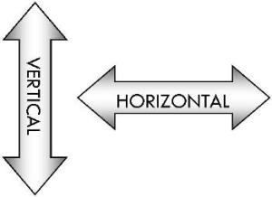
Vertical effect vs Horizontal Effect
Private Individuals / Undertakings vs Member State – Van Gend en Loos (Vertical Direct effect)
Private Individuals/ Undertakings vs Private Individuals vs Undertaking – Defrenne vs Sabeena (Horizontal Direct Effect)

Slide 24
Are Regulations Directly Effective?
YES!
BUT
Depends on the terms of the regulation
Are they sufficiently clear?
Are they unconditional?
If they are then a regulation has HORIZONTAL and VERTICAL direct effect

Slide 25
What about Directives?
First interpretation – not directly effective since they are always conditional on Member States transposition
But this was a problem!
Member States were not implementing directives and private citizens had no effective remedy

Slide 26
Van Duyn v Home Office C-41/74
Van Duyn not allowed to enter UK due to being a member of an undesirable organisation
Van Duyn argued that this was in violation of Directive 64/221
UK Government argued that Directive 64/221 was not yet implemented
“…. It would be incompatible with the binding effect attributed to a directive by Article 189 to exclude, in principle, the possibility that the obligation which it imposes may be invoked by those concerned.”

Slide 27
Sufficiently precise and unconditional Directives
Francovich v Republic of Italy – C-6/90
In order to be sufficiently precise and unconditional, it is necessary to be able to:
Identify the persons who are entitled to the right;
Ascertain the content of that right
Identify the person / body liable to provide that right

Slide 28
Are Directives enforced against private individuals?
Marshall v Southamption Area C-152/84
A directive cannot be relied upon as such against a person because it cannot impose obligations upon individuals
Paola Faccini Dori v Recreb SRl – C-91/92

Slide 29
What is the definition of a ‘State’
Foster v British Case C-188/89
A body is an ‘emanation of the state’ where:
Provides a public service
Under state control
Having special powers

Slide 30
Indirect effect
Interpretation by national courts of national law in the light of the wording and the purpose of the directive.
Harz v Deutche Tradax (C-79/83)
Marleasing SA v La Comercial SA (C-106/89)
Courts may also interpret a provision of national law that preceded a directive

Slide 31
Principle of State Liability
State’s legal responsibility for damages suffered by individual due state’s failure to act or implement a measure
Treaty did not create a mechanism of remedying state liability
Francovich and Bonifaci v Italy (C-6/90 and 9/90)
Was the Directive directly effectives?
Could compensation be given by the State for failure to implement a Directive?

Slide 32
Conditions for liability
1. Directive must necessarily contain rights conferred on individuals
2. Rights could be identified from the provisions of the directive
3. Causal link between the failure to implement legislation and the damage suffered by the person affected
Other judgments developed further on the principle of state liability

Slide 33
Diploma in Law (Malta)

