Slide 1
Introduction to Organisational Change and Development
Calvin Cassar
19/11/21

Slide 2
Session Outline
Ice Breaker
Understanding Change
Models of Change
Lewin
Kotter
Kubler-Ross
The Role of Leadership in Change

Slide 5
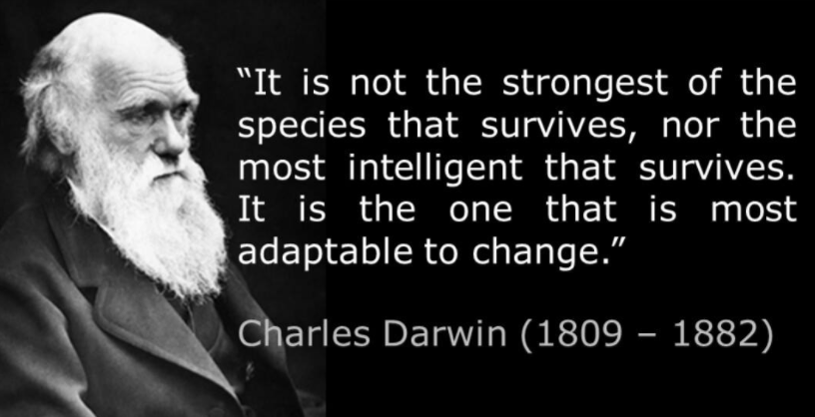

Slide 6
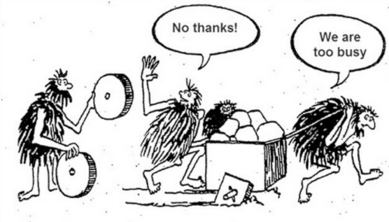

Slide 10
Understanding Change
The Merriam- Webster Online Dictionary defines ‘Change’ as:
a: to make different in some particular
b : to make radically different
c : to replace with another

Slide 11
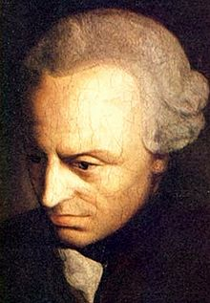
Understanding Change
Within Organisations there is recognition that change is important for allowing retention of a competitive edge.
“Business as usual" is change.
We all see the value of change, but in turn we all tend to resist change.

Slide 12
Understanding Change
Organisations are involved in the management of different types of change. These include:
Structural Change
Strategic Change
People Change
Change in Processes

Slide 14
Models of Change
Theories have tried to describe the process of change through the development of models.
A model is a representation of an idea, object, process or system that is used when variables cannot be fully controlled or isolated.
Models allow the generation of hypotheses.
Models can eventually be developed into a theory which can be used to predict phenomena given a specific set of variable.

Slide 15
Models of Change
A theory tends to be parsimonious (Occam’s Razor).
A theory can be tested.
A theory is supported by independent strands of evidence.
A theory can be refuted (falsiable), given specific observations.
A theory can be used to make predictions.

Slide 16
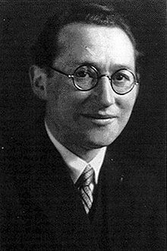
Models for Change
Lewin’s 3-Stage Model of Change
Lewin was a German-American social psychologist. He fled and was exiled from his home country.
He is widely considered to be the father of social psychology as he studied key aspects such as teams, group dynamics and organisational development.

Slide 17
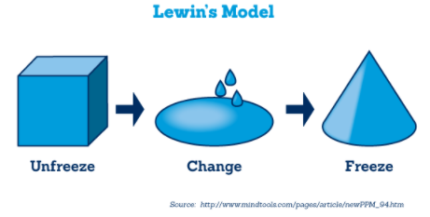
Models of Change
Lewin’s 3- Stage Model of Change

Slide 18
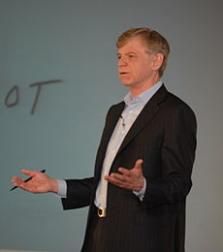
Models of Change
Kotter’s 8-Stage Model of Change
Kotter is an American researcher who in the mid-90s proposed an influential model for describing organisational change.
The model was described in Leading Change which Times Magazine listed as one of the top 25 business publications of all time.

Slide 19
Models of Change
Kotter’s 8-Stage Model of Change
Step 1 – Create Urgency
Employees need to see the value of the change initiatives and this can be obtained through data and persuasion.
Look for persons who can support change.
Identify threats and opportunities.

Slide 20
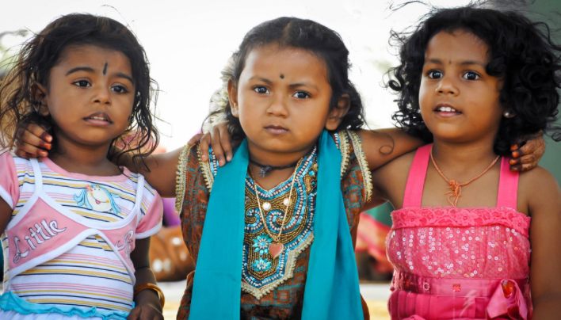
Models of Change
Kotter’s 8-Stage Model of Change
Step 2 – Form a Powerful Coalition
Identify key stakeholders and influencers.
Work on team building within the Coalition.
Have a good mix in the team and not simply a repeat of the leader.

Slide 21
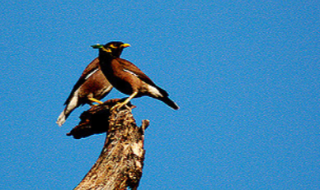
Models of Change
Kotter’s 8-Stage Model of Change
Step 3 – Create a Vision for Change
Determine the values that are central for the team.
Create a strategy.
Make sure that the strategy is instilled within the change coalition.

Slide 22
Models of Change
Kotter’s 8-Stage Model of Change
Step 4 – Communicate the Vision
Vision should not be just communicated in meetings but should be part of ongoing discourse.
Address people’s concerns and anxiety openly.
Apply the vision in all aspects of organisational culture

Slide 23
Models of Change
Kotter’s 8-Stage Model of Change
Step 5 – Remove Obstacles
Remove any barriers that may inhibit change.
Identify, hire or train employees who share the vision.
Recognise and rewards change agents.

Slide 24
Models of Change
Kotter’s 8-Stage Model of Change
Step 6 – Create Short Term Wins
Success is motivating.
Through quick wins one can give a taste of the benefits through change.
Make sure that an early goal can be achieved, despite the input from critics.

Slide 25
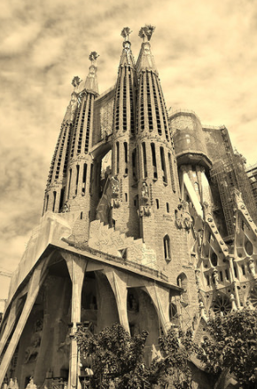
Models of Change
Kotter’s 8-Stage Model of Change
Step 7 – Build on the Change
After every change or success, analyse what went well and what did not.
Set goals to continue building on the momentum.
Keep ideas fresh

Slide 26
Models of Change
Kotter’s 8-Stage Model of Change
Step 8 – Anchor the Changes in the Corporate Culture
For change to stick it should become part of the culture.
Leaders should continue to be open and supportive of change.

Slide 27
Models of Change

Slide 28
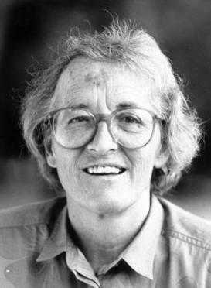
Models of Change
Elisabeth Kubler-Ross’ Model of Change
Was a Swiss-American psychiatrist.
Was originally interested in studying the terminally ill.
Her most notable publication in On Death and Dying which was published in 1969.

Slide 29
Models of Change
Elisabeth Kubler-Ross’ Model of Change
She proposed a model featuring the five-stages of grief, which she observed to be generally universal when persons are experiencing near death situations.
Her model is generally referenced through the acronym DABDA which stands for the initial of each stage.

Slide 30
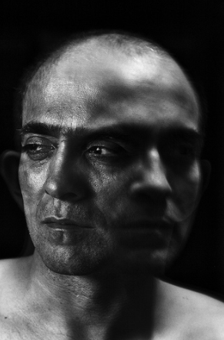
Models of Change
Elisabeth Kubler-Ross’ Model of Change
Stage 1: Denial
The diagnosis is seen as mistaken – this is not happening to me.
Ex. Steve Jobs when diagnosed with pancreatic cancer

Slide 31
Models of Change
Elisabeth Kubler-Ross’ Model of Change
Stage 2: Anger
Frustration then ensues – why me? Why would this happen?

Slide 32
Models of Change
Elisabeth Kubler-Ross’ Model of Change
Stage 3: Bargaining
Persons then tend to switch to bargaining or negotiation to avoid the unwanted consequence.
I can be a better person if I get better…

Slide 33
Models of Change
Elisabeth Kubler-Ross’ Model of Change
Stage 4: Depression
The reality sinks in and persons may start avoiding social interactions and seek isolation.
“Nothing matters as I am going to die”

Slide 34
Models of Change
Elisabeth Kubler-Ross’ Model of Change
Stage 5: Acceptance
Calm sets in, and individuals may look retrospectively at their lives in an emotionally controller manner.
“It’s going to be OK”

Slide 35
Models of Change
Elisabeth Kubler-Ross’ Model of Change
The cycle can be observed in a myriad of real-life situations.
With minor changes, this model has been used to review different aspects of organisational behaviour, from collective lay-offs, individual terminations, as well as individual responses to change.

Slide 36
Models of Change

Slide 37
Models of Change
What are the common characteristics in the change models?
What are the differences in the change models?
In your opinion which model best sums up organisational change?

Slide 38
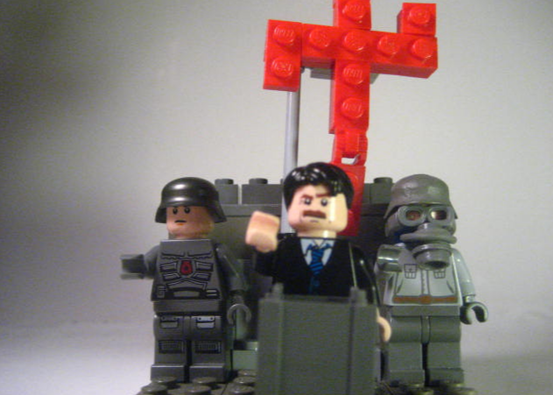
The Role of Leadership in Change

Slide 39
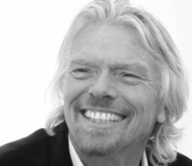
The Role of Leadership in Change
Transactional and Transformational Leadership
Some researchers sought to differentiate between transactional leadership and transformational leadership.
Significant field in this dichotomy were carried out by James McGregor Burns and Bernard Bass.

Slide 40
The Role of Leadership in Change
Transactional leadership is also known as managerial leadership, focuses on supervision, organization, and performance; transactional leadership is a style of leadership in which leaders promote compliance by followers through both rewards and punishments.
Transformational leadership is a style of leadership where a leader works with subordinates to identify needed change, creating a vision to guide the change through inspiration, and executing the change in tandem with committed members of a group

Slide 41
The Role of Leadership in Change
Transformational leaders look into:
Emphasizing intrinsic motivation and positive development of followers
Raising awareness of moral standards
Highlighting important priorities
Fostering higher moral maturity in followers
Creating an ethical climate (share values, high ethical standards)

Slide 42
The Role of Leadership in Change
Transformational leaders look into:
Promoting cooperation and harmony
Using authentic, consistent means
Using persuasive appeals based on reason
Providing individual coaching and mentoring for followers
Appealing to the ideals of followers
Allowing freedom of choice for followers

Slide 43
The Role of Leadership in Change
Transactional Leadership brings about change through planning, organization, distribution of work and monitoring of performance.
Transformational leadership brings about change through the setting up of a vision, purpose, and the creation of a coalition working towards the achievement of the results.
There is no necessarily universal right way of approaching change, but rather approaches that hold different value under different circumstances.

